Slide 1








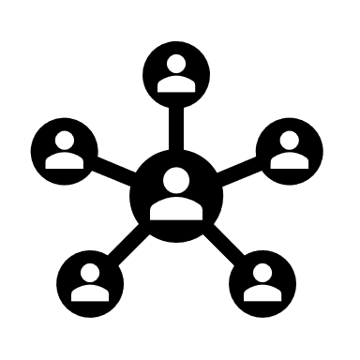


Event Hub guaranteeing delivery and ensuring schema adherence
Producer Apps
Event Hub
Consumer Apps
Event 1 with Schema 1
Event Registry Wrapper
The wrapper is build around the set of REST APIs from Lenses. It enforces schema on messages through Lenses.io service registry. Also, through the curation of logs and monitoring REST APIs, it ensures that number of messages published are subscribed successfully
Event 1 with Schema 1
Event 2 with Schema 1
Writes the event to the topic with an entry into the event registry wrapper/schema registry
Reads the event from the topic with an entry into the event registry wrapper/schema registry
Event 2 with Schema 1
Event 3 with Schema 1
Event 1 with Schema 2
Event 1 with Schema 2
Event 3 with Schema 3
Event 2 with Incorrect Schema 2
Event 3 with Schema 3
Recon Service
Event 3 with No Schema
Lenses.io Schema Registry
A Service that polls Lenses.io/Event Registry logs and keeps track of the events not consumed as expected Event 3 with Schema 1 not consumed yet!
Formats the events per authorized schema and writes into the corresponding topic
Retrieves the schema for respective topic from the registry and formats the events accordingly. Also, the developers registers the schema during the creation of topic.
Error Topic
Retrieves the schema for respective topic from the registry and formats the consumed events accordingly. Also, checks the Recon service to ensure delivery.
Event 2 with Incorrect Schema 2
Developers of Producing Apps
Event 3 with No Schema
Developers of Consuming Apps

